Slide 1
Journey Scrapbook
Akshat Gupta
Batch-6

Slide 2
Foundational Training Week - 1
18-Aug-2023

Slide 3
Day 1
Introduction to BA
SDLC Model
Requirement Analysis
Agile Practices
What and Why of Sprint
SCRUM
VSTS – Set up

Slide 4
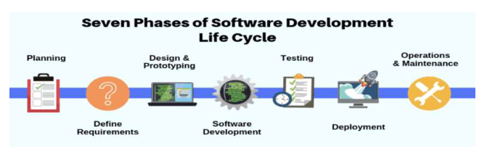
Introduction to BA
Business Analysis is the practice of enabling change in an organizational context, by defining needs and recommending solutions that deliver value to stakeholders.
SDLC Model
A framework that describes the activities performed at each stage of a software development project.

Slide 5
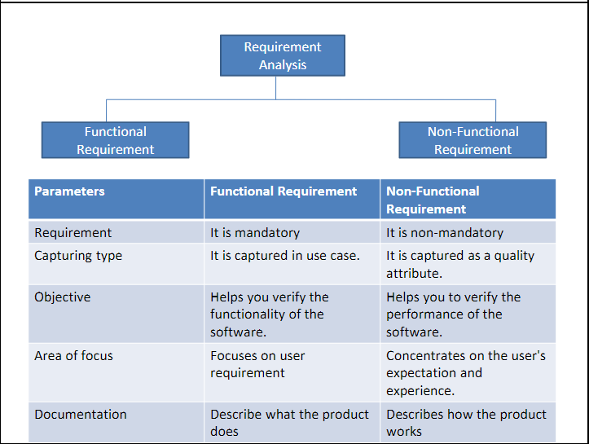
Requirement Analysis
Process of defining user expectations for a new software being built or modified.
-Functional Requirement - Non-Functional Requirement

Slide 6
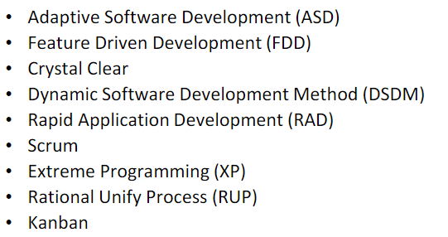
Agile Methods

Slide 7
SCRUM
Planning: Sprint Planning Meeting
Implementation: Burndown chart and Impediment log
Review: Sprint Review Meeting
Retrospect: Sprint Retrospective Meeting
Daily Scrum: Daily meeting to review progress towards achieving the goal
Sprint: Period of 2 weeks during which a given goal gets accomplished

Slide 8
Thank you
Akshat Gupta
Akshat.gupta2@shell.com

